Slide 1

The modular Open Source
Data Platform
✔
Your data,
your platform
✔
Open source,
up to date
✔
Data mesh
ready

Slide 2















Stackable in a Nutshell
Founded
2020
Stackable Data Platform
Our Customers
Open Source
Infrastructure as Code
Cloud-native (Kubernetes)
On-Premises, Cloud, Hybrid
Our Team: 20 People
International
in Germany & Europe
Our Services
Network - Collaborations
Product Support
Big Data Consulting
Trainings

Slide 3



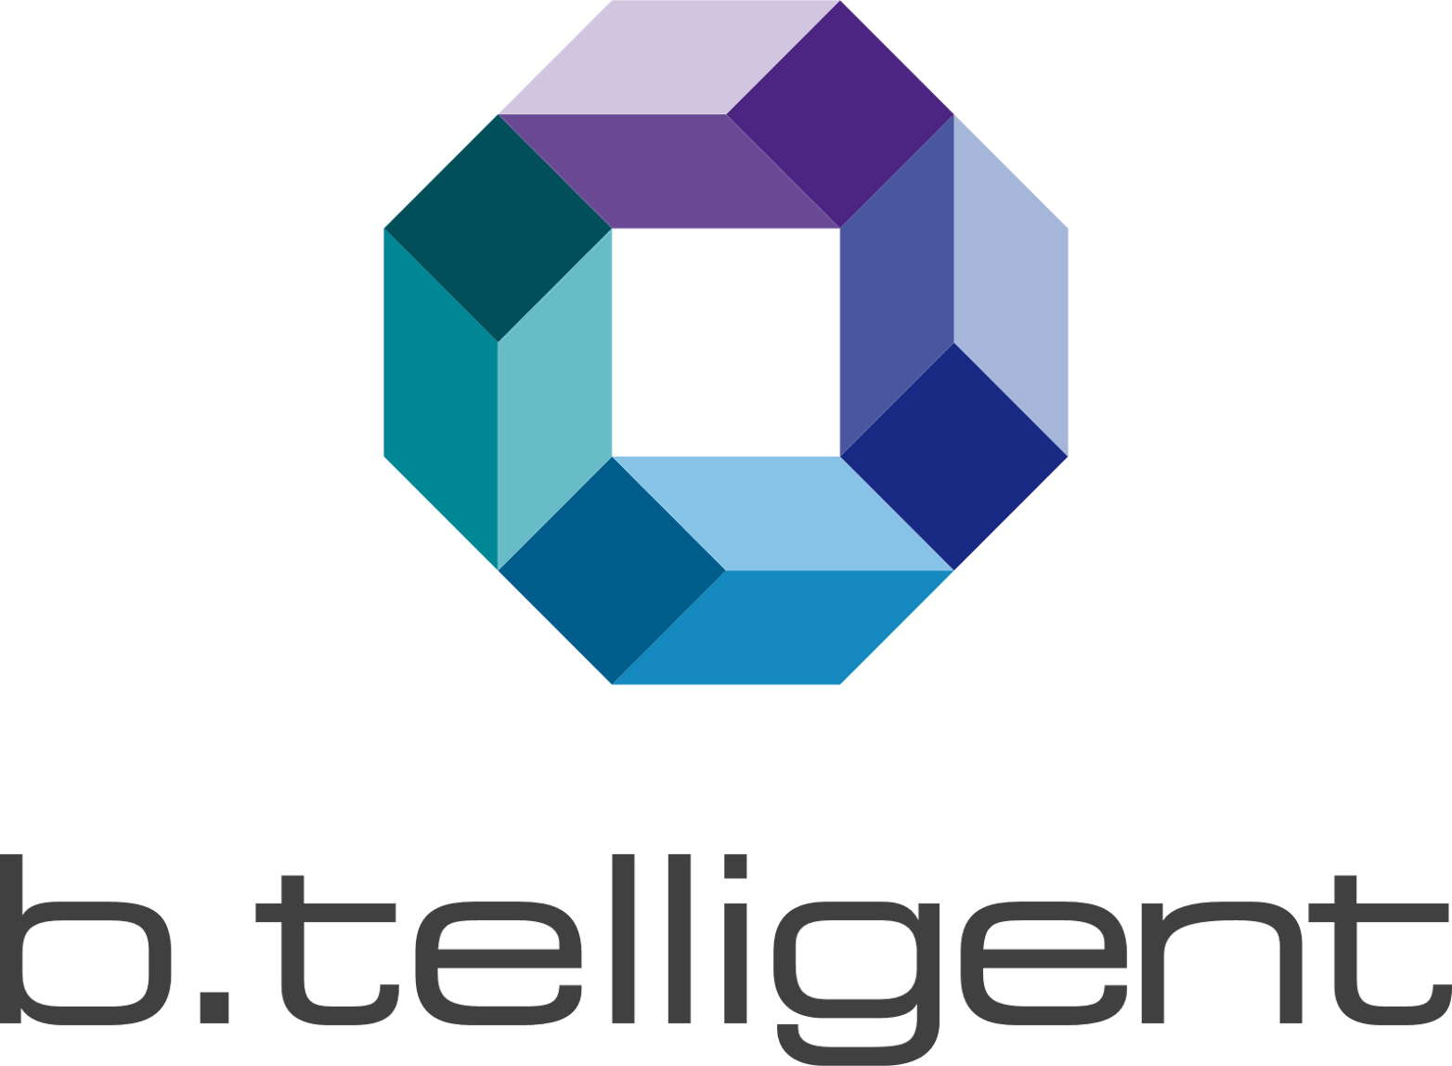

Stackable – a Joint Venture between
Strategic focus on open source software
Capital and developers for the further development of Stackable
Data centres in Europe
GDPR & ISO 27001 certified
Consortium partner in funded GAIA-X projects
Deep technology expertise in the Big Data ecosystem
Large and sustainable network of Big Data and streaming customers in Europe
Resilient network of experts and partners in the field of big data and streaming
Many years of expert knowledge of the data & analytics market
Access to 250+ clients in DACH across all industries
Strong market presence and network
Support of Stackable through the shared services organisation of b.telligent

Slide 4

Stackable core values
technology driven
We are experts with an international reputation in what we do.
1
holistic approach
Full ecosystem support for all marketable Open-Source Big Data & Streaming tools from one source.
technology driven
holistic approach
2
european
3
european
We work according to European standards for the European market.
open
4
open
We support with open source at fair prices for support.
Notes:
Stackable mission, stackable core values
Technology driven
Holistic approach
European
open

Slide 5
Stackable Data Platform

Slide 6









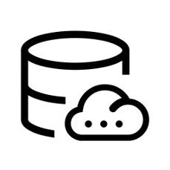


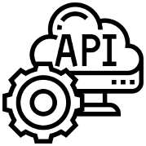




Your data, your platform!
ingest
store & process
serve
Business systems
Unlimited data volumes
Financial
application
Reporting /
BI
Machine
sensors
Dashboards
Control Panel
Batch processing & Event Streaming in near real time
Smart meter
sensors
Stackable Data Platform
Data Science
Machine Learning
AI
Social
Media
Various data formats
& structures
E-Commerce /
Retailer
APIs
Pictures /
Videos
Cloud or
datacenter
Applications
Data products
Weather
Satellites
Notes:
Stackable mission, stackable core values
Technology driven
Holistic approach
European
open

Slide 7
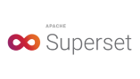
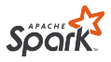
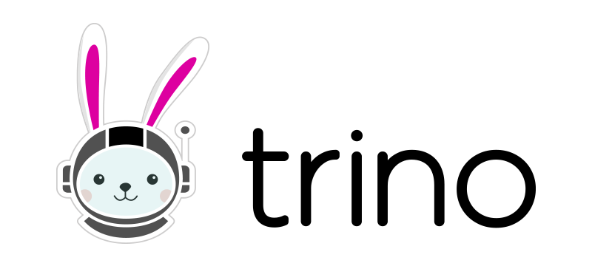

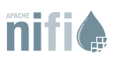

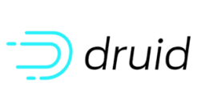

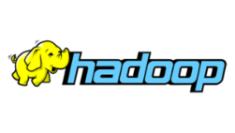


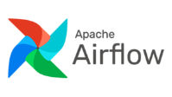
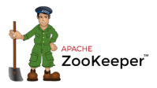
Popular Data Apps. Kubernetes-native. Easy to deploy and operate.
Data visualization
Analytics & AI
Security
Monitoring
Prometheus
100% Open Source
modular and flexible
In every Cloud and in your own Data Center
as Managed Service in IONOS Cloud
Data processing
Storage
Data integration
Infrastructure
orchestration

Slide 8
Why Stackable?
Openness by Open Source
Integration by Code
Flexibility by Modularity
Enterprise ready by design
Multiple platforms
European by GAIA-X
Open source product
Community driven
Re-use vs. re-invent
No vendor lock-in
Facilitate Data sovereignty
Infrastructure as Code
Security as Code
Open APIs
Implementing open standards
Modular architecture
Individual solution configuration
per component updates
Monitoring & Alerting interfaces
Logging & Auditing
Ubiquitous security
Cloud-native
On private and public clouds or hybrid
Selfmanaged or as-a-Service at IONOS Cloud
AKS, EKS, GKS, OpenShift, …
Intel & Arm support
GAIA-X compliant
Supporting GAIA-X Federation Services

Slide 9
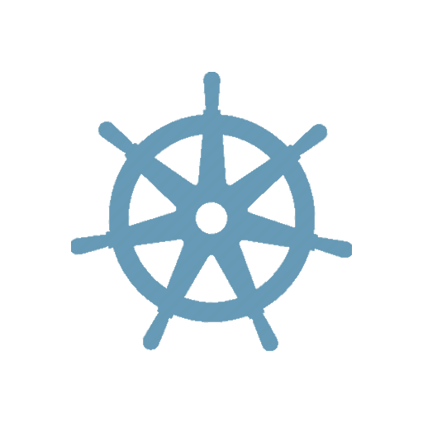





Define your Data Platform as Code
define once …
deploy many …
…wherever you want
Stackable Data Platform:
On-premises
Zookeeper Cluster
Nifi Cluster
Kafka Cluster
A comprehensive set of software components playing together to
deploy,
manage,
monitor,
update and
secure
current open source products using a 100% Infrastructure-as-Code approach
Git Repository
deploy
control
Zookeeper Cluster
Nifi Cluster
Kafka Cluster
Cloud

Slide 10

Tooling

Slide 11
Tooling Overview
Kubernetes
Helm
kubectl
k9s
YAML
stackablectl
Automating deployment, scaling and management of containerized applications.
Used by all managed cloud providers.
Kubernetes package manager
Install, remove or update applications
Simple sharing
Rollbacks
Command line tool for communicat-ing with a Kubernetes cluster.
List, apply, remove and manage resources in a cluster.
Simple command line UI to manage and view Kubernetes cluster resources.
Easy to use for people that do not memorize all kubectl commands.
YAML is a human friendly data serialization language.
Similar to JSON but more powerful.
Most resources we apply are written in YAML.
The Stackable command line tool.
Manage Stackable releases, stacks or operators.
Create defined and apply clusters with just one command.

Slide 12
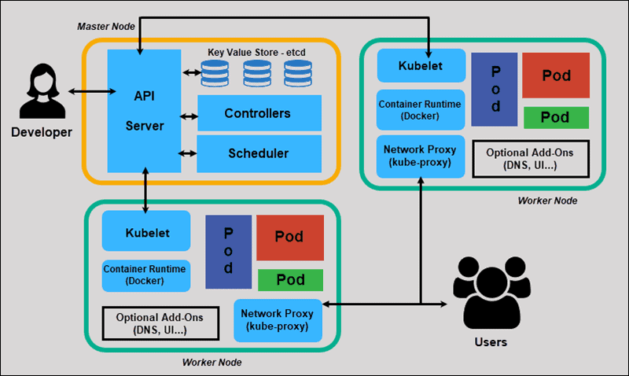
Common vocabulary
Pod | Pods are the smallest deployable units of computing that you can create and manage in Kubernetes. A is a group of one or more containers, with shared storage and network resources, and a specification for how to run the containers.
Node | Kubernetes runs your workload by placing containers into Pods to run on Nodes. A node may be a virtual or physical machine, depending on the cluster. Each node is managed by the control plane.
ConfigMap | A ConfigMap is an API object used to store non-confidential data in key-value pairs. Pods can consume ConfigMaps as environment variables, command-line arguments, or as configuration files in a volume.
Volume | On-disk files in a container are ephemeral, which presents some problems for non-trivial applications when running in containers. One problem is the loss of files when a container crashes. The kubelet restarts the container with a clean state. The Kubernetes volume abstraction solves both of these problems.
Service | An abstract way to expose an application running on a set of Pods as a network service. An abstract way to expose an application running on a set of Pods as a network service.
Namespace | Namespaces provide a mechanism for isolating groups of resources within a single cluster. Names of resources need to be unique within a namespace, but not across namespaces.
Kubernetes
Kubernetes architecture (Ref: https://phoenixnap.com/kb/understanding-kubernetes-architecture-diagrams)

Slide 13
YAML vs JSON syntax
YAML
students: - name: John age: 18 address: street: foostreet 47 city: London - name: Marie age: 19 address: street: barstreet 11 city: Manchester | { “students”: [ { “name”: “John”, “age”: 18, “address”: { “street”: “foostreet 47”, “city”: “London” }, }, { “name”: “Marie”, “age”: 19, “address”: { “street”: “barstreet 11”, “city”: “Manchester” }, }, ] }
YAML (YAML Ain't Markup Language) is a data serialization language used as the input format for diverse software applications
In YAML, key-value pairs are defined and separated with a colon. Keys are unique identifiers to which one or multiple values can be assigned.
YAML is frequently an alternative to the data interchange format JSON. Both are alternatives to XML (Extensible Markup Language). Both YAML and JSON are intended to be human-readable formats, although JSON more easily transfers from one programming language environment to another.

Slide 14
Useful kubectl commands
Enable autocompletion (e.g. bash)
source <(kubectl completion bash)
Create a resource
kubectl apply -f ./my-manifest.yaml
List pods and output in yaml format
kubectl get pods -o yaml
Delete pods and services with label name=myLabel
kubectl delete pods,services -l name=myLabel
Scale a resource specified in "foo.yaml" to 3
kubectl scale --replicas=3 -f foo.yaml
Get pod logs of my-pod
kubectl logs my-pod
kubectl
Kubernetes provides a command line tool for communicating with a Kubernetes cluster's control plane, using the Kubernetes API. This is called kubectl.
For configuration, kubectl looks for a file named config in the $HOME/.kube directory. You can specify other kubeconfig files by setting the KUBECONFIG environment variable or by setting the --kubeconfig flag.
The KUBECONFIG is a file containing connection details to connect to a specific cluster
Cheatsheet https://kubernetes.io/docs/reference/kubectl/cheatsheet/

Slide 15
Useful Helm commands
List repositories
helm repo list
Add repositories
helm repo add [repository-name] [url]
Install apps from charts
helm install [app-name] [chart] --values [yaml-file/url]
Upgrade a release. If it does not exist on the system, install
helm upgrade [release] [chart] --install
Uninstall release
helm uninstall [release]
List all available releases across all namespaces
helm list --all-namespaces
Helm
The most important concept of Helm is a chart. A Chart is a set of Kubernetes YAML manifests grouped together. Helm charts make it possible to deploy a containerized application using a single command.
Charts are grouped in online collections called repositories. Each repository has a name and URL, making the charts easy to locate, download, and install.
A release is a single instance of a chart deployed in a Kubernetes cluster.
Cheatsheet:
https://github.com/RehanSaeed/Helm-Cheat-Sheet

Slide 16
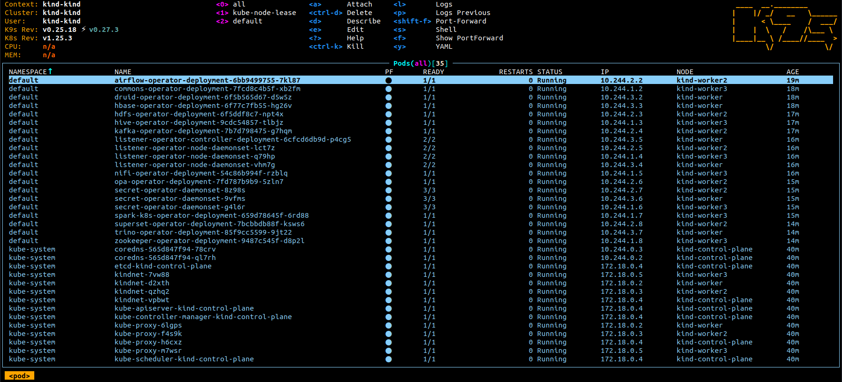
k9s
Features
Tracks in real-time activities of resources running in your Kubernetes cluster
Handles both Kubernetes standard resources as well as custom resource definitions
Tracks real-time metrics associates with resources such as pods, containers and nodes
Provides standard cluster management commands such as logs, scaling, port-forwards, restarts…
Define your own command shortcuts for quick navigation via command aliases and hotkeys.
Plugin support to extend K9s to create your very own cluster commands.
Powerful filtering mode to allow user to drill down and view workload related resources.

Slide 17
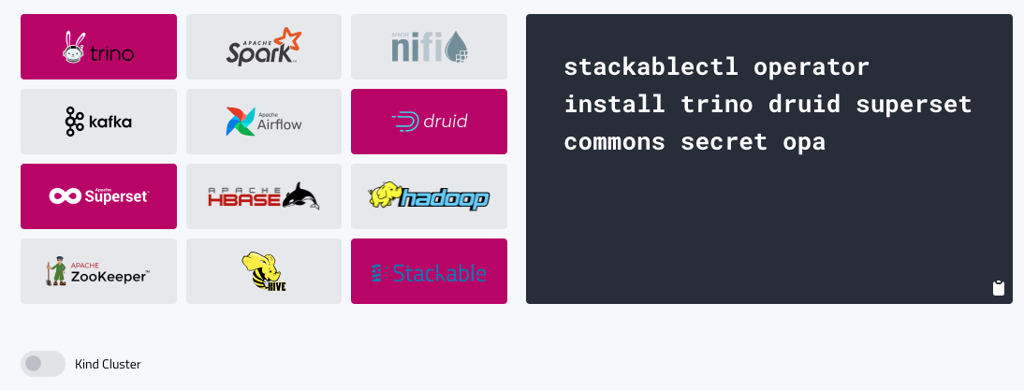
stackablectl
Your Big Data installation up and running with one command*:
*Prerequisites: These tools are expected to be installed on your machine: Docker / Kubernetes / Helm
Notes:
Main target groups

Slide 18

Stackable
Products

Slide 19
Popular Data Apps. Kubernetes-native. Easy to deploy and operate.
Data visualization
Analytics & AI
Security
Monitoring
Prometheus
100% Open Source
modular and flexible
In every Cloud and in your own Data Center
as Managed Service in IONOS Cloud
Data processing
Storage
Data integration
Infrastructure
orchestration

Slide 20
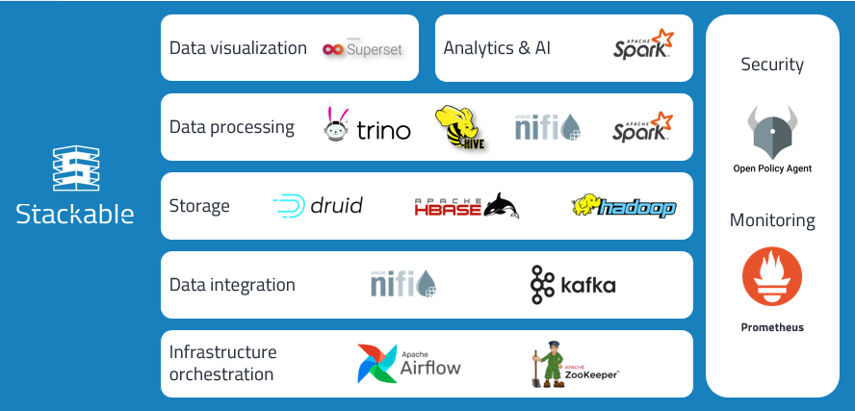
Infrastructure orchestration
Apache ZooKeeper
Apache Airflow
Apache ZooKeeper is an open-source server for highly reliable distributed coordination of cloud applications.
ZooKeeper is essentially a service for distributed systems offering a hierarchical key-value store, which is used to provide a distributed configuration service, synchronization service, and naming registry for large distributed systems.
Required for Tools like Apache NiFi, Apache Kafka, Apache HBase, Apache Hadoop
Apache Airflow is an open-source workflow management platform for data engineering pipelines. It started at Airbnb in October 2014 as a solution to manage the company's increasingly complex workflows.
Airflow uses directed acyclic graphs (DAGs) to manage workflow orchestration. Tasks and dependencies are defined in Python and then Airflow manages the scheduling and execution. DAGs can be run either on a defined schedule (e.g. hourly or daily) or based on external event triggers (e.g. a file appearing in Hive).

Slide 21
Data integration
Apache NiFi
Apache Kafka
Apache NiFi is a software project from the Apache Software Foundation designed to automate the flow of data between software systems. Leveraging the concept of extract, transform, load (ETL), it is based on the "NiagaraFiles" software previously developed by the NSA.
The software design is based on the flow-based programming model and offers features which prominently include the ability to operate within clusters, security using TLS encryption, extensibility (users can write their own software to extend its abilities) and improved usability.
Apache Kafka is a distributed event store and stream-processing platform. It is an open-source system developed by the Apache Software Foundation written in Java and Scala.
The project aims to provide a unified, high-throughput, low-latency platform for handling real-time data feeds.
Kafka can connect to external systems (for data import/export) via Kafka Connect, and provides the Kafka Streams libraries for stream processing applications

Slide 22
Data storage
Apache Hadoop
Apache HBase
Apache Druid
Apache Hadoop is a collection of open-source software utilities that facilitates using a network of many computers to solve problems involving massive amounts of data and computation.
It provides a software framework for distributed storage and processing of big data using the MapReduce programming model.
Hadoop was originally designed for computer clusters built from commodity hardware, which is still the common use. It has since also found use on clusters of higher-end hardware.
HBase is an open-source non-relational distributed database modeled after Google's Bigtable and written in Java.
It is developed as part of Apache Software Foundation's Apache Hadoop project and runs on top of HDFS.
It provides a fault-tolerant way of storing large quantities of sparse data (small amounts of information caught within a large collection of empty or unimportant data, such as finding the 50 largest items in a group of 2 billion records.
Druid is a column-oriented, open-source, distributed data store written in Java.
Druid is designed to quickly ingest massive quantities of event data, and provide low-latency queries on top of the data.
Fully deployed, Druid runs as a cluster of specialized processes (called nodes in Druid) to support a fault-tolerant architecture where data is stored redundantly, and there is no single point of failure.

Slide 23
Data processing
Trino
Apache Hive
Apache Spark
Trino is an open-source distributed SQL query engine designed to query large data sets distributed over one or more heterogeneous data sources.
Trino can query datalakes that contain open column-oriented data file formats like Parquet residing on different storage systems like HDFS, AWS S3, using the Hive and Iceberg table formats.
Trino also has the ability to run federated queries that query tables in different data sources such as PostgreSQL or Kafka.
Apache Hive is a data warehouse software project built on top of Apache Hadoop for providing data query and analysis.
Hive gives an SQL-like interface to query data stored in various databases and file systems that integrate with Hadoop.
Traditional SQL queries must be implemented in the MapReduce Java API to execute SQL applications and queries over distributed data.
Apache Spark is an open-source unified analytics engine for large-scale data processing. Spark provides an interface for programming clusters with implicit data parallelism and fault tolerance.
Apache Spark has its architectural foundation in the resilient distributed dataset (RDD), a read-only multiset of data items distributed over a cluster of machines, that is maintained in a fault-tolerant way.
* Apache NiFi is missing here which can also be used for Data processing.

Slide 24
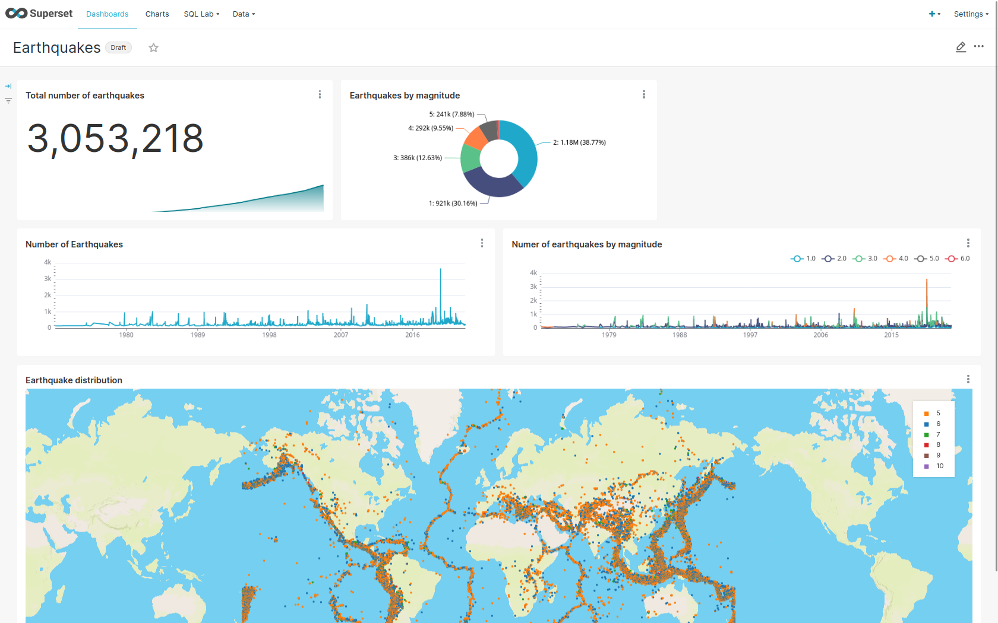
Data visualization
Apache Superset
Apache Superset is an open-source software application for data exploration and data visualization able to handle data at petabyte scale.
Superset is fast, lightweight, intuitive, and loaded with options that make it easy for users of all skill sets to explore and visualize their data, from simple line charts to highly detailed geospatial charts.

Slide 25
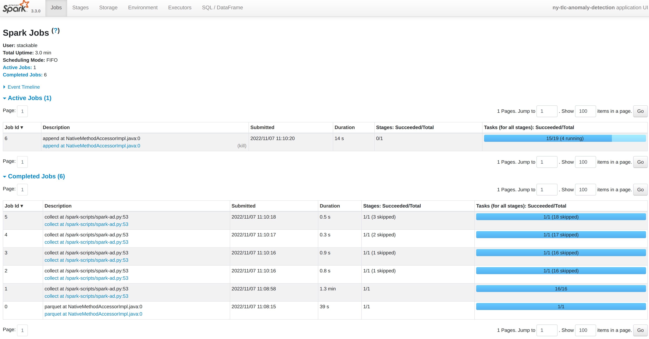
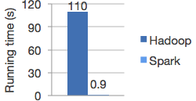
Analytics & AI
Apache Spark (MLlib)
MLlib fits into Spark's APIs and interoperates with NumPy in Python (as of Spark 0.9) and R libraries (as of Spark 1.5). You can use any Hadoop data source (e.g. HDFS, HBase, or local files), making it easy to plug into Hadoop workflows.
High-quality algorithms, 100x faster than MapReduce
Spark runs on Hadoop, Apache Mesos, Kubernetes, standalone, or in the cloud, against diverse data sources

Slide 26





Streaming & Big Data Infrastructure as Code on Kubernetes
Stackable
Repositories
Stackable Control Plane (Operators)
Data Platform Deployment
Stackable Nifi Operator
Nifi Cluster
Stackable Helm Repository
Nifi
CRD
Kafka Cluster
install
control
Stackable Kafka Operator
Kafka
CRD
control
Data Platform Definitions
Repository
deploy
Zookeeper Cluster
Stackable Zookeeper Operator
ZK
CRD
CRD
control
Stackable
Container Registry

Slide 27
Deploy into different Environments – Multiple Clouds
IONOS Managed Kubernetes
Stackable
Repositories
IMK CRD
Kafka Cluster
Stackable Helm Repository
Nifi Cluster
Zookeeper Cluster
IMK CRD
Data Platform Definitions
Repository
deploy
Azure Managed Kubernetes (AKS)
AKS CRD
Stackable
Container Registry
AKS CRD
Kafka Cluster
Nifi Cluster
Zookeeper Cluster

Slide 28
Deploy into different Environments – Multiple Stages
Development Environment
Stackable
Repositories
Stackable Control Plane (Operators)
Zookeeper Cluster
Kafka Cluster
Nifi Cluster
Stackable Helm Repository
Dev CRD
Data Platform Definitions
Repository
deploy
Dev CRD
Prod CRD
Prod CRD
Stackable
Container Registry
Zookeeper Cluster
Nifi Cluster
Kafka Cluster
Production Environment

Slide 29
Thank you

